Slide 1
WALMART PRO
Group No - 19
Selvin Charles Tuscano
Vinay Gangadhara
Sijoy Almeida
Nikesh Biraggari
Abhinav Chary Eeranti

Slide 2
OVERVIEW
Walmart Pro is a online business management platform designed to revolutionize the e-commerce experience. It offers comprehensive solutions that help businesses establish and grow their online presence, aiming to streamline the entire e-commerce process.
Walmart Pro is committed to making the management of online businesses seamless and efficient, distinguishing itself in the competitive digital marketplace with its user-friendly interface and powerful functionalities.

Slide 3
OBJECTIVES
The primary objective of WalmartPro is to simplify and enhance the e-commerce lifecycle for businesses through a centralized and intuitive platform.
Additionally, WalmartPro seeks to streamline processes for setting up and managing online stores, including product listing, inventory tracking, order processing, and customer interactions.
A comprehensive database underpins the system, allowing for the consolidation of critical business data and analytics to aid in informed decision-making and optimize online operations.
Key goals include providing a user-friendly interface that caters to all levels of technical ability, ensuring easy navigation and efficient platform management.

Slide 4
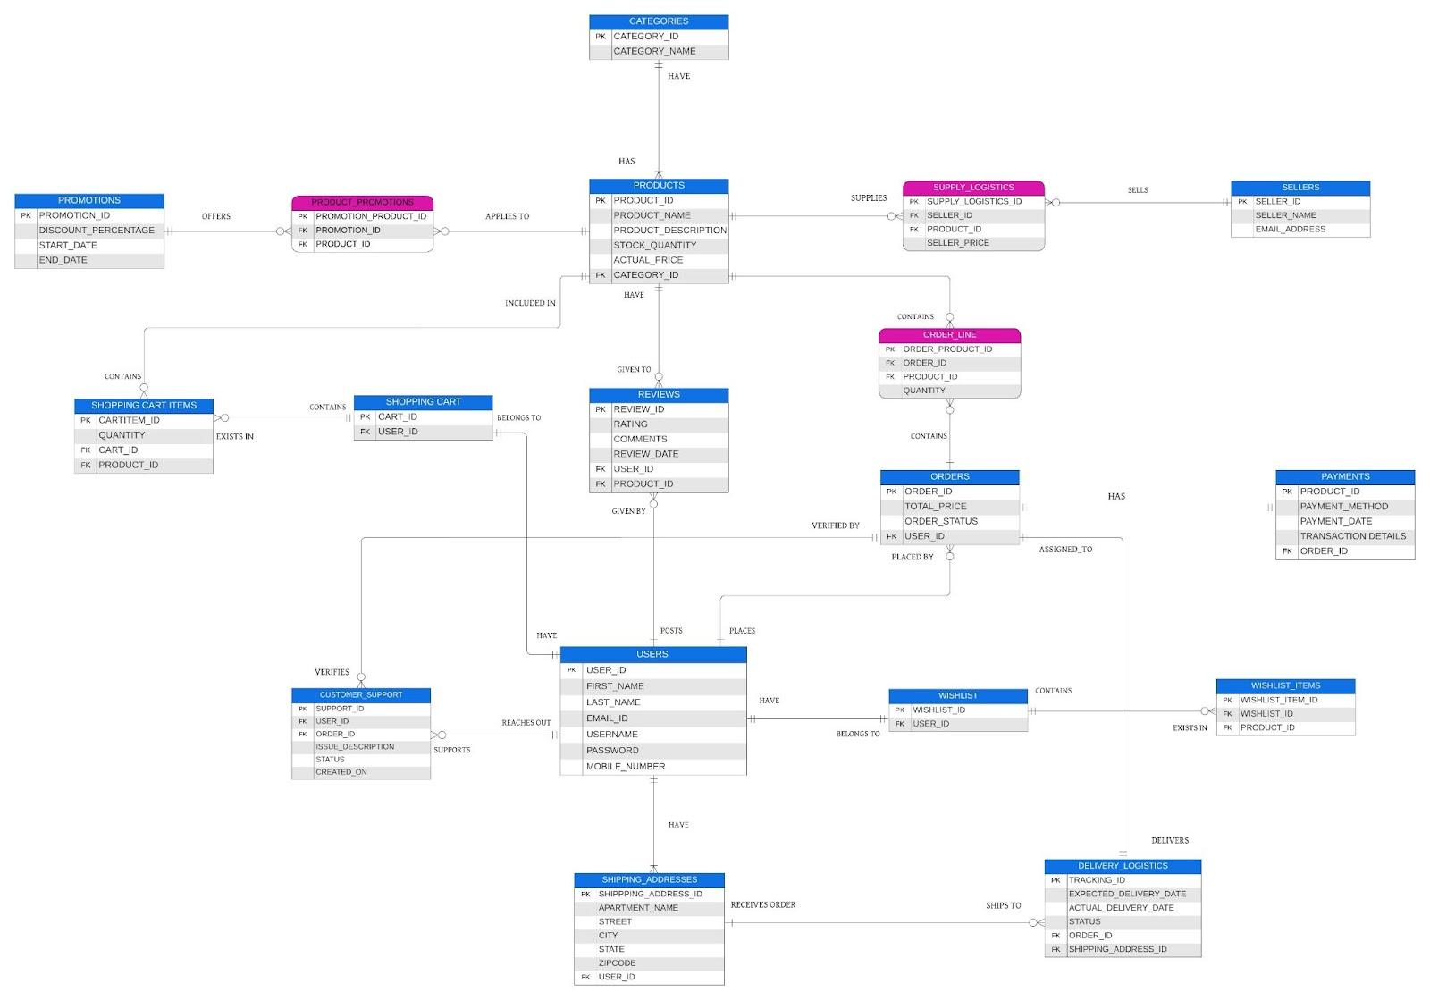
ENTITY-RELATIONSHIP DIAGRAM

Slide 5
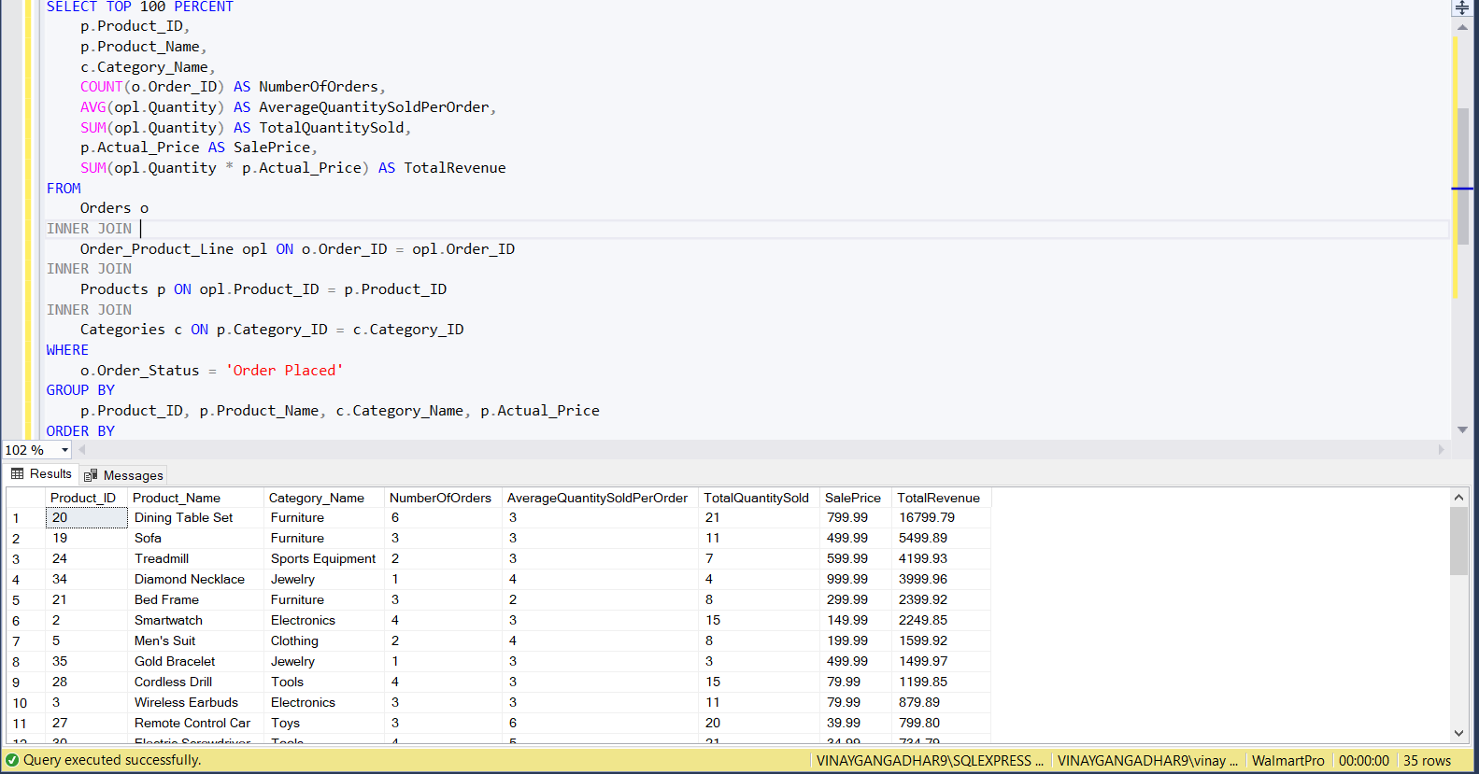
VIEWS
The SQL code selects sales data for products from an e-commerce database. It retrieves product ID, name, category, the number of orders, average quantity sold per order, total quantity sold, sale price, and total revenue generated. The data is filtered to include only those orders where the status is 'Order Placed'. The results are grouped by product ID, product name, category name, and sale price, indicating it is meant to provide a comprehensive analysis of product performance. The query is set to select only up to 100 percent of the rows, which essentially means all rows.

Slide 6
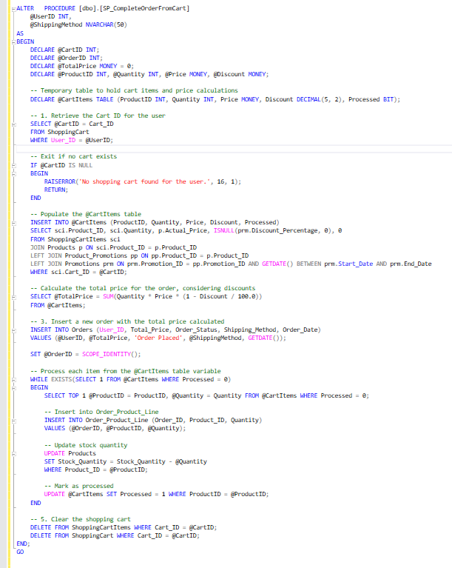
STORED PROCEDURES
The SQL procedure SP_CompleteOrderFromCart facilitates the checkout process . It first identifies the shopping cart associated with a given user and aborts if no cart is found. Next, it populates a temporary table with the cart items, applying any applicable discounts to compute the total price of the order. A new order record is then created with this total price and associated details like shipping method and order date. Following that, it processes each cart item by inserting them into the order line item table, updating the product stock quantities, and marking them as processed. Finally, it empties the user's shopping cart by deleting the cart items and the cart itself.

Slide 7
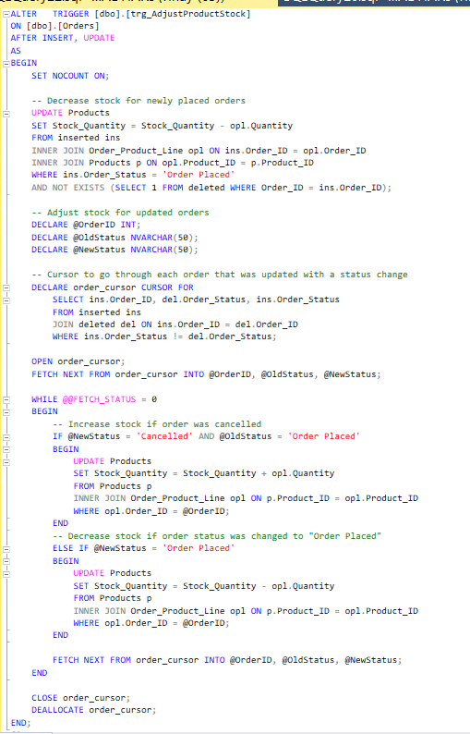
TRIGGERS
The SQL trigger trg_AdjustProductStock is set on the Orders table to run after insert or update operations. For new orders with the status 'Order Placed', it decreases the product stock quantities by the amount specified in the order. It also handles stock adjustments when an order status is updated: if an order is cancelled, it increases the product stock back; if an order status changes to 'Order Placed', it decreases the stock. This is done using a cursor that iterates over each order that has a status change, checking the previous and new statuses to determine the correct stock adjustment. After processing, the cursor is closed and deallocated.

Slide 8
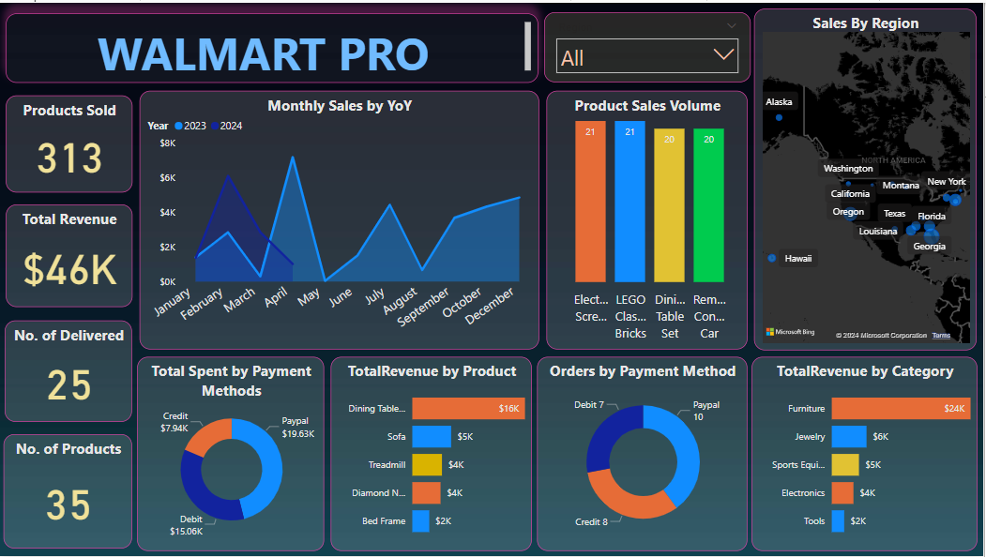
POWERBI VISUALIZATIONS

Slide 9
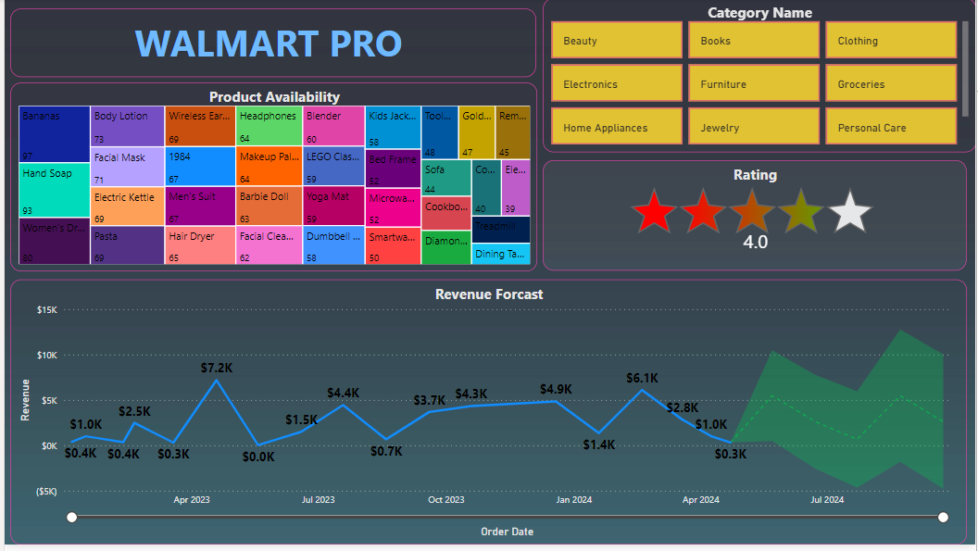

Slide 10
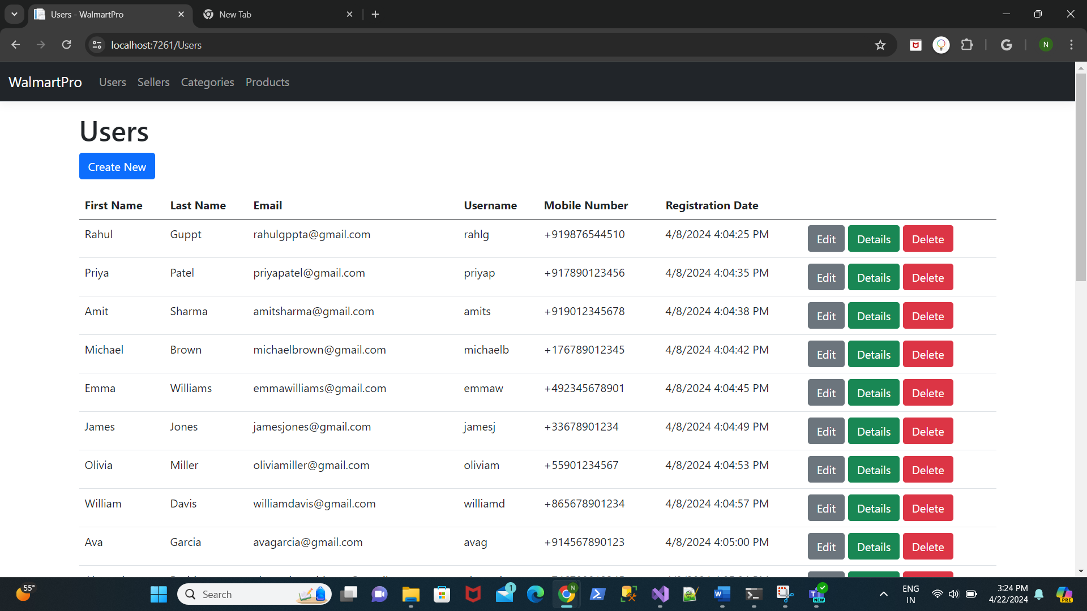
WALMART PRO WEB APPLICATION (GUI)

Slide 11
THANK YOU!

